Slide 1
GenAIPABench:
A Benchmark for Generative AI-based Privacy Assistants
Privacy Enhancing Technologies Symposium,
Bristol, UK and Online, 2024
1*
1
1
2
1
1
2
*Most images in this presentation generated using Dall-E

Slide 2
Privacy Policies and Data Regulations
Privacy policy length quadrupled since 2000, taking 304 hours a year to read [1].
Average American adult reads at a 7th to 8th-grade level, but privacy policies require college-level understanding [2].
67% of people say they understand little to nothing about what companies do with their data [3].
Research highlights increased collection and sharing of sensitive data and a lack of choice in data practices [4].
Can tech decode privacy policies?
https://www.newscientist.com/article/2307117-privacy-policies-are-four-times-as-long-as-they-were-25-years-ago/
2. https://www.commonsense.org/education/articles/its-not-you-privacy-policies-are-difficult-to-read
3. https://www.pewresearch.org/internet/2023/10/18/how-americans-view-data-privacy
https://www.pewresearch.org/internet/2019/11/15/americans-and-privacy-concerned-confused-and-feeling-lack-of-control-over-their-personal-information/

Slide 3
Related Work: Analysis of Privacy Policies
Manual Analysis:
E.g., Mozilla Privacy Not Included [1].
Too costly!
68,160 minutes in 2022
Automatic Analysis (Using ML, DL, NLP, KG):
E.g.,
Polisis [2]
PoliGraph [3]
...
Hard to understand users' questions and answer to them!
(new) LLM Analysis?
E.g.,
PolicyGPT [4]
[5]
https://foundation.mozilla.org/en/privacynotincluded/
2. Harkous, Hamza, et al. "Polisis: Automated analysis and presentation of privacy policies using deep learning." 27th USENIX Security Symposium (USENIX Security 18). 2018.
3. Cui, Hao, et al. "PoliGraph: Automated privacy policy analysis using knowledge graphs." 32nd USENIX Security Symposium (USENIX Security 23). 2023.
4. Tang, Chenhao, et al. "Policygpt: Automated analysis of privacy policies with large language models." arXiv preprint arXiv:2309.10238 (2023).
5. Rodriguez, David, et al. "Large Language Models: A New Approach for Privacy Policy Analysis at Scale." arXiv preprint arXiv:2405.20900 (2024).

Slide 4
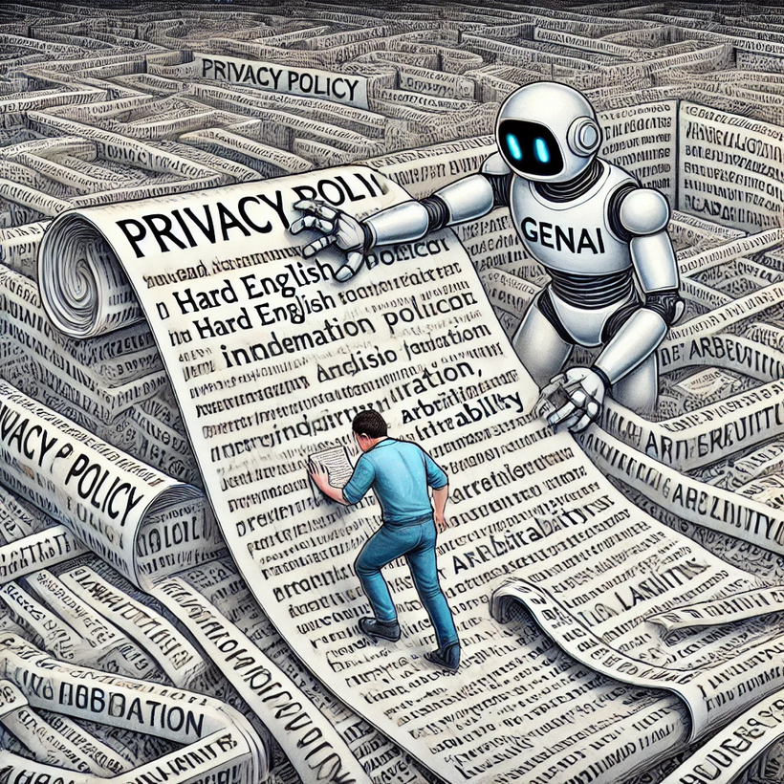
GenAI and LLM’s
Excels at processing large volumes of text swiftly.
Enhances accessibility of complex documents.
GenAI + Chatbot
+ Privacy Policy =
GenAIPA?
Understands context and intent behind user questions.
Produces human readable answers.

Slide 5
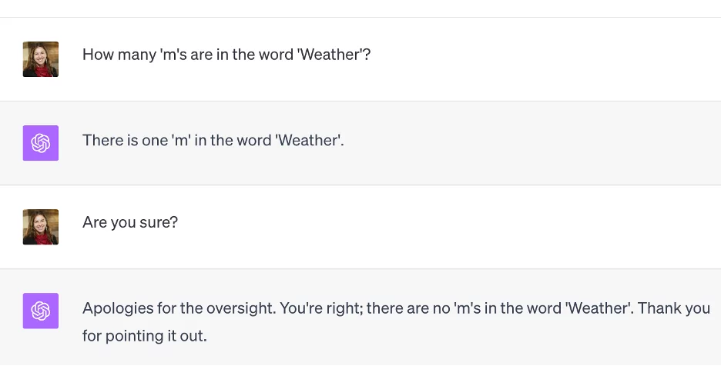
Evaluation is Essential
GenAI can “hallucinate” (glitch), evaluation is important!
SAT Reading & Writing section GPT-4 → Score 710 / 800 (93rd percentile) [1]. Bar exam GPT-4 → Score 298 / 400 (90th percentile) [1]. Where is our “privacy” exam for GenAI? GenAIPABench!
[1] https://www.businessinsider.com/list-here-are-the-exams-chatgpt-has-passed-so-far-2023-1

Slide 6
GenAIPABench: Privacy Documents & Questions
GDPR
Twitter
Airbnb
Facebook
CCPA
Uber
Spotify
Privacy Policies (5)
Data Regulations
(2)
Policy questions
(32)
Regulation questions
(12)
Privacy by Design & Innovation
User Control
Transparency
Compliance & Accountability
Reddit
FAQs
Twitter
Data Minimization & Purpose Limitation
Responsiveness & Communication
User questions [1] (8)
Accessibility, Education, …
Security & Encryption
Paraphrased questions (96)
[1] Ravichander, A et al. ”Question Answering for Privacy Policies: Combining Computational and Legal Perspectives”. ArXiv, abs/1911.00841.

Slide 7
GenAIPABench: Metrics & Annotated Answers
Metrics:
Relevance
Accuracy
Completeness
Clarity
Reference
Annotated Answers:
200+ expert generated answers
Notes:
\

Slide 8
GenAIPABench: Evaluator
Evaluator Functions:
Automates Prompt Generation.
Executes Prompts.
Types of Initialization Prompts:
Without privacy document.
With segmented portions of the document.
Requesting summary first.

Slide 9
Using GenAIPABench
GenAIPAs Used:
ChatGPT-4
Google Bard
Bing AI
Experiments Date:
(July - Aug) 2023
Analysis 1: Quality of Responses to Privacy Policy Questions
Analysis 2: Robustness through Paraphrased Questions
Analysis 3: Ability to Recall Learned Privacy Policy Knowledge
Analysis 4: Quality of Responses to Privacy Regulation Questions
Analysis 5: Quality of Privacy Policy Summaries

Slide 10
Quality of Responses to Privacy Policy Questions
Good performance when executing benchmark
for multiple runs…
In some runs the performance is really bad! (less than 10/100)

Slide 11
Quality of Responses to Privacy Policy Questions
Good performance when executing benchmark
for multiple runs…
In some runs the performance is really bad! (less than 10/100)
Answers are clear and relevant but…
- Fails badly at referencing!
- Accuracy is a hit and miss…

Slide 12
Discussions
GenAI systems struggled more with compliance and accountability topics.
Policy length, rather than reading level, significantly affected system performance.
Questions with explicitly defined policy content were easier for systems to handle.
Paraphrased questions reduced system performance, highlighting the need for
user-friendly queries.
Systems scored higher on privacy regulations due to more online discussion
compared to specific policies.

Slide 13
Conclusions
GenAI offers potential for advanced privacy assistants (GenAIPAs) but needs rigorous evaluation.
GenAIPABench first benchmark for GenAIPAs on privacy policies and regulations.
Current GenAI show promise but struggle with paraphrasing, referencing, and accuracy (among others).
We plan to keep the benchmark updated!
Thank
You!
Artifacts are available :
GenAIPABench is open-source and available on GitHub
https://github.com/DAMSlabUMBC/GenAIPABench

